Slide 1
OBJECT DETECTION IN POINT CLOUD - POLE
JAGRUTI VICHARE
NAVEENKUMAR SIVASUBRAMANIAN
SABAREESH SURESH

Slide 2
OBJECTIVE
The prime focus of this project is to develop a pole detection algorithm.
Representation of the detected poles through line segment.

Slide 3
Point Cloud
Point cloud (3D coordinate system) to represent the external surface of an object.
Utilized to automatically locate, segment and classify pole in an urban environment.
There are basically four types of object which can be obtained from daily scenarios like: lane, guardrail, pole, road surface etc.

Slide 4
Point Cloud Data
Input: final_project_point_cloud.fuse
• Format: [latitude] [longitude] [altitude] [intensity]
• Data file is then read and each point is converted into (x,y,z)
coordinates using cartesian(latitude, longitude, altitude).

Slide 5
Approach
Preprocessing
coordinate transformation for each point cloud
Smoothening , Edge detection, Hough Transform
Pole detection
Object file generation

Slide 6

GRAY SCALE CONVERSION

Slide 7

SMOOTHENING

Slide 8
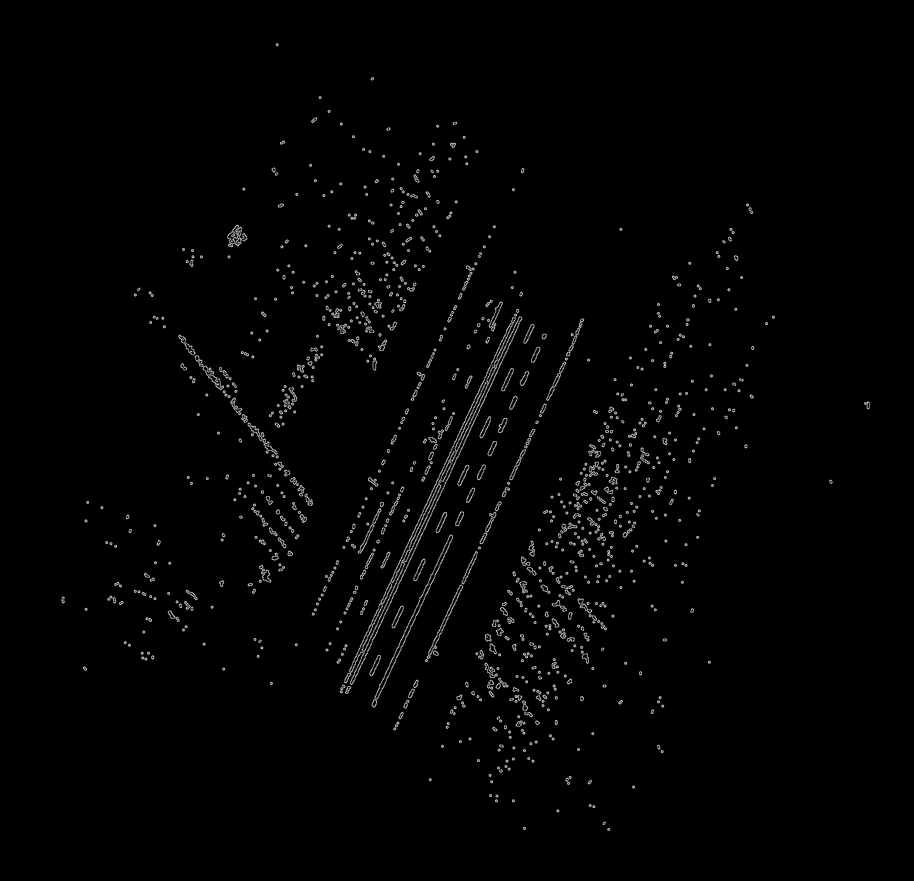
EDGE DETECTION

Slide 9
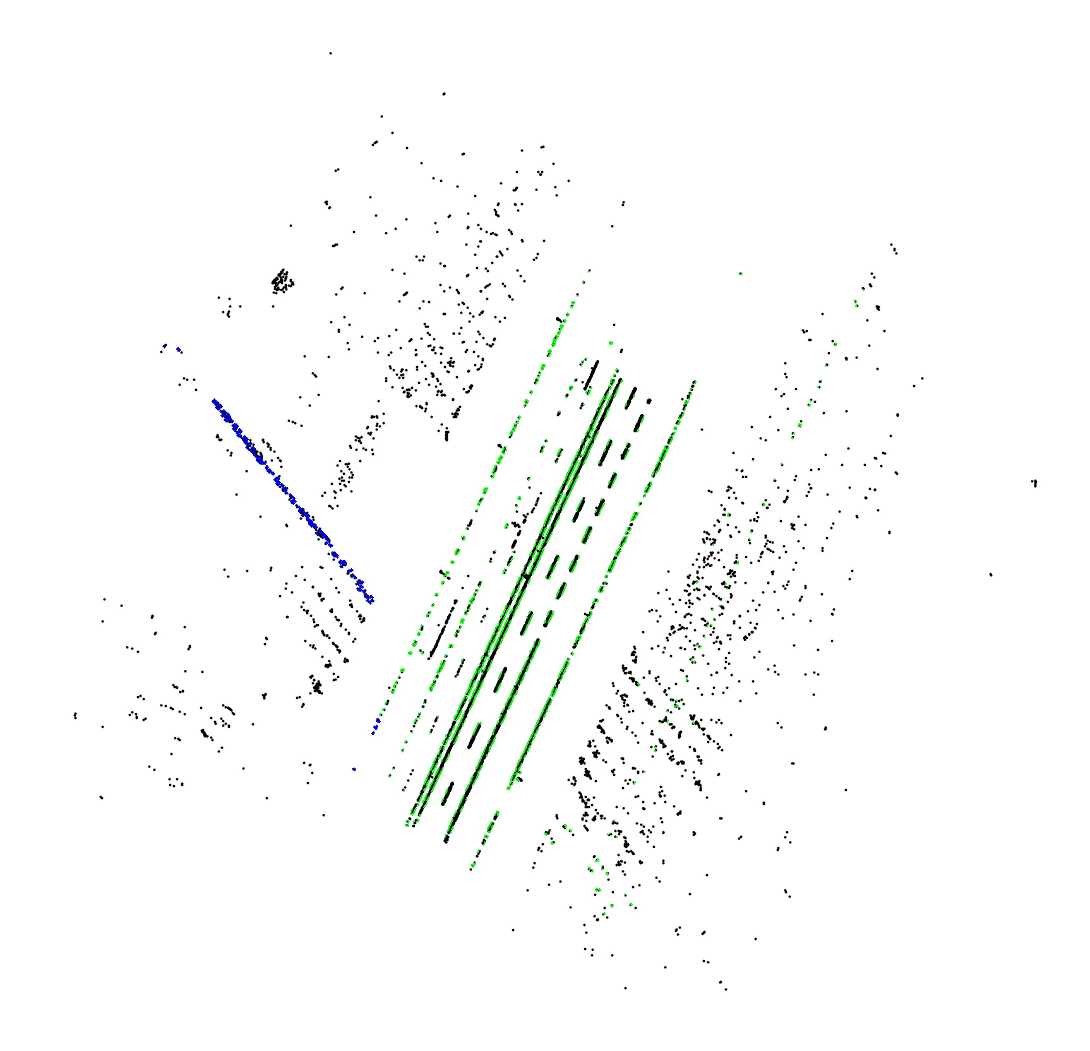
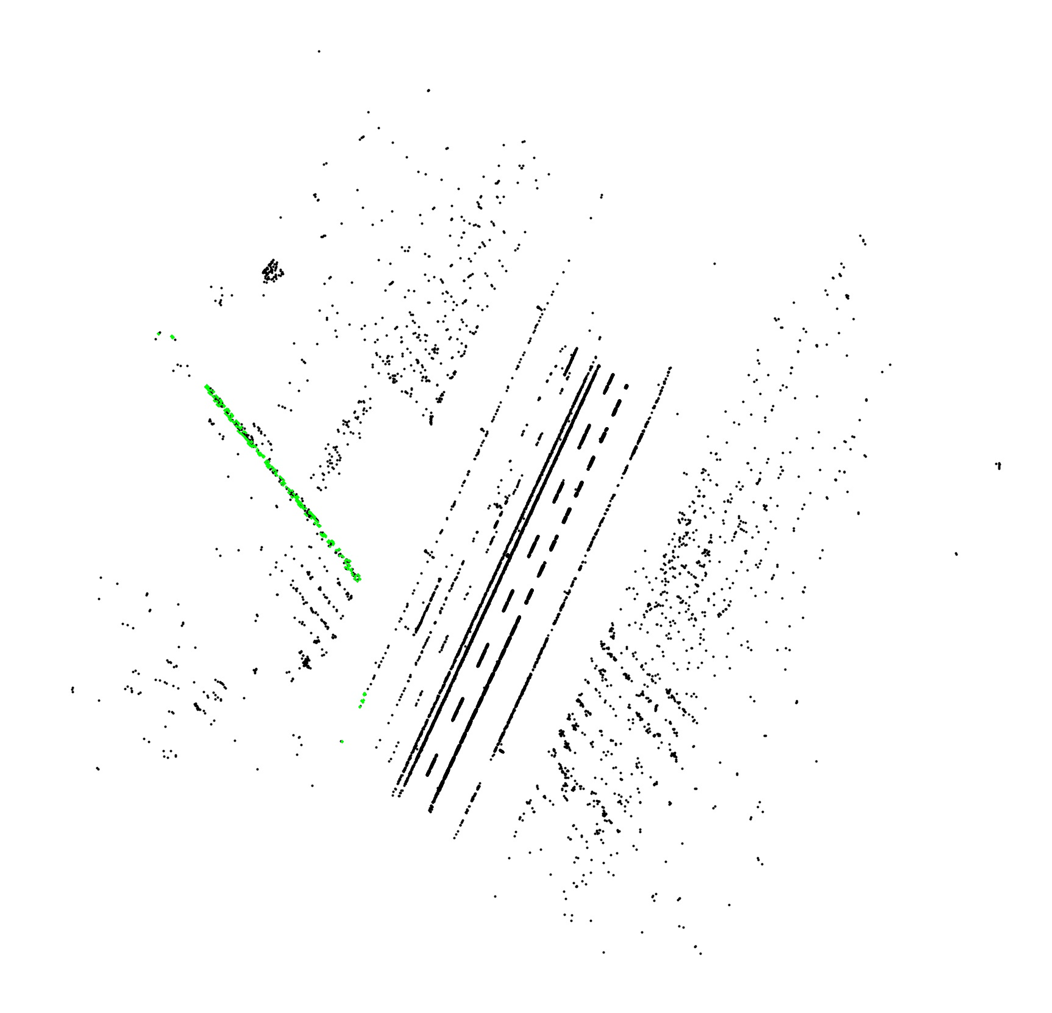
POLE DETECTION – FINAL RESULTS

Slide 10
MAJOR ROLE
Creat, update accurate maps and spatial databases
Automated Driving to ease the safety of drivers preventing accidents
Popular in HD Map and Sensor-Based autonomous driving
City management, urban planning, and intelligent transportation systems
Accurate land cover information helps to make policy decisions, and improve land use planning

Slide 11
IMPROVEMENTS
Implement more accurate method to handle ground plane
Further developing the outlier filter
To detect more number of significant points for potential improvement
Instead of just relying on density, we could better define what “outlier” is pole detection scenario

Slide 12
FURTHER ENHANCEMENT
Divide each image into Left, Mid, Right.
Pole Detection algorithm can focus on the needed part to avoid the distortion by vehicles.

Slide 13
References
Lecture Slides – Class 7
Paper Reference: http://www.cs.princeton.edu/~funk/iccv09.pdf
Reference link for the function which converts latitude, longitude and elevation to x y z.
http://stackoverflow.com/questions/8981943/lat-long-to-x-y-zposition-in-js-not-working

